Slide 1
B8 QV133FHB-N81 Product Specification Rev.P1
SUPPLIER | Chongqing BOE Optoelectronics CO., LTD
FG-Code | QV133FHB-N81-8D32
BOE Optoelectronics Technology Co., Ltd

Slide 2
REV. | ECN NO. | DESCRIPTION OF CHANGES | DATE | PREPARED
P0 | - | Initial Release | 2020.7.28 | Qiao Handan
P1 | - | LCD FOB Electrical Specifications | 2022.10.26 | Zhao yuanpei
REVIEWED
Designer | Manager
Zhang Shouqiang(Array) | Wang Wu
Teng Zhengyuan(Cell) | Li Zhe
Liu Chao(CF) | Li Min
Zhao Yuanpei(EE) | Zhang jian
Li Bo(MO) | Sun Yansheng
Long Yudan(QE) | Cui Chaoyang
Liu Zhiqiang(PI) | Chen Gang
APPROVED
Qiu yujing(PM)

Slide 3
Contents
No. | Items | Page
1.0 | General Description | 4
2.0 | Absolute Maximum ratings | 6
3.0 | Electrical specifications. | 7
4.0 | Interface Connection | 9
5.0 | Signal Timing Specifications | 11
6.0 | Power Sequence | 12
7.0 | Optical specifications. | 13
8.0 | Mechanical Outline Dimension | 15
9.0 | Reliability Test | 17
10.0 | Precautions | 18
11.0 | Label | 22
12.0 | Packing information | 24

Slide 4
1.0 GENERAL DESCRIPTION
1.0.1 Introduction
QV133FHB-N81 is a color active matrix TFT LCD FOB using amorphous silicon TFT's (Thin Film Transistors) as an active switching devices. This FOB has a 13.3 inch diagonally measured active area with Full-HD resolutions (1920 horizontal by 1080 vertical pixel array). Each pixel is divided into RED, GREEN, BLUE dots which are arranged in vertical stripe and this FOB can display 16.7 M colors.
VLED
LED Driver
Connector
TFT LCD
1920 x 1080
Sourse Driver
eDP Input Signal
BACK LIGHT (Fluorescent Lamp)
VDD
DC/DC
Gamma
Vcom
Figure 1. Drive Architecture
1.0.2 Features
2 lane eDP1.4b interface with 2.7Gbps link rates
Thin and light weight
16.7M color depth, color gamut 72%
On board LED driver circuit
On board EDID chip
1.0.3 Application
● Video Phone/IP Phone/Smart Key/ e-cigarettes etc.

Slide 5
1.0.4 General Specification
< Table 1. General Specifications >
Parameter | Specification | Unit | Remarks
Active area | 293.76 (H) x 165.24 (V) | mm
Number of pixels | 1920 (H) ×1080 (V) | Pixels
Pixel pitch | 0.153 (H) X 0.153 (V) | mm
Pixel arrangement | RGB Vertical stripe
Display colors | 16.7M | Colors | 8Bit
Display mode | Normally Black
Dimensional outline | 298.36 (H) × 199.72(V) × 1.086 (D) typ. | mm
Weight | 150 | g
Surface treatment | FineAG

Slide 6
2.0 ABSOLUTE MAXIMUM RATINGS
The followings are maximum values which, if exceed, may cause faulty operation or
damage to the unit. The operational and non-operational maximum voltage and current
values are listed in Table 2.
< Table 2. Environment Absolute Maximum Ratings>
[Ta =25±2 ℃]
Parameter | Symbol | Min. | Max. | Unit | Remarks
Power Supply Voltage | VDD | -0.3 | 5.5 | V | Ta = 25 ℃ Note 1&2
Operating Temperature | T_{OP} | 0 | 50 | ℃ | Environment Temperature
Storage Temperature | T_{ST} | -20 | 60 | ℃
Operating Ambient Humidity | Hop | - | 90 | %RH
Storage Humidity | Hst | - | 90 | %RH
Heat Release Requirement | Trls | 15 |  | ℃ | Note3 仅适用于Q/Single/FOG出货项目
Note:
These range above is maximum value not the actual operating temperature . Actual Operating temperature is no more than 50℃ and temperature refers to the LCM surface temperature ;
BOE is not responsible for product problems beyond the use conditions.
When the ambient temperature is T ℃, the surface temperature of Panel can not exceed (T+15)℃.

Slide 7

3.0 ELECTRICAL SPECIFICATIONS
3.1 TFT LCD FOB
< Table3. LCD FOB Electrical Specifications >
[Ta =25±2 ℃]
Parameter |  | Symbol | Values |  |  | Unit | Notes
 |  |  | Min | Typ | Max
Power Supply Input Voltage |  | V_{DD} | 3.0 | 3.3 | 3.6 | V | Note 1
Power Supply Current |  | I_{DD} | - | 300 | 700 | mA
Power Consumption |  | P_{DD} | - | 0.99 | 2.1 | W
Rush current |  | I_{Rush} | - | - | 2 | A | Note 2
LED Driver Power Supply Voltage |  | H_{VDD} | 10.8 | 12 | 13.2 | V
LED Driver Power Supply Current |  | I_{HVDD} | - | - | 300 | mA
LED Power Consumption |  | P_{LED} | - | - | 3.6 | W
eDP Interface | Main link swing voltage | V_{com} | 100 | - | 1320 | mV
 | Common mode voltage | V_{cm} | 0 | - | 2 | V
Notes : 1. The supply voltage is measured and specified at the interface connector of FOB.
The current draw and power consumption specified is for 3.3V at 25 ℃
Max value at H 1 Line Pattern
a) Typ : Mosaic Pattern
b) Max : H1L Pattern
2. The duration of rush current is about 2ms and rising time of Power Input is 1ms(min)
(a)
(b)

Slide 8
3.2 Back-light Unit
< Table 4. LED Driving guideline specifications >
Ta=25+/-2°C
Parameter |  |  | Min. | Typ. | Max. | Unit | Remarks
Power supply voltage for Back light |  | V_{LED} | - | - | 20 | V
Power supply Current for Back light |  | I_{LED} | - | - | 150 | mA | 6 Channel 25mA/CH
Power supply for Back light |  | P_{LED} | - | - | 3 | W | Note 1
EN Control Level | Backlight on | V_{ENH} | 2 | - | - | V | EN logic high voltage
 | Backlight off | V_{ENL} | 0 | - | 0.8 | V | EN logic low voltage
PWM Control Level | PWM High Level | V_{PML} | 2 | - | - | V
 | PWM Low Level | V_{PML} | 0 | - | 0.8 | V
PWM Control Frequency |  | F_{PWM} | 0.2 | - | 10 | KHz
Duty Ratio |  | - | 1 | - | 100 | %
Notes : 1. Calculator Value for reference I_{LED} × V_{LED} = P_{LED}
2. The LED Life-time define as the estimated time to 50% degradation of initial
luminous under the condition of the ambient temperature of 25℃.

Slide 9
4.0 INTERFACE CONNECTION.
4.0.1 Electrical Interface Connection
The electronics interface connector is IS050-L30B-C10.
The LED connector is MSK24022P10D
The connector interface pin assignments are listed in Table 5 and 6.
<Table 5. Pin Assignments for the Interface Connector>
PIN # | Symbol | Description Remark | PIN # | Symbol | Description Remark
1 | CABC-EN | CABC-EN | 16 | GND | Power Ground
2 | GND | Power Ground | 17 | HPD | Hot plug detect output
3 | LANE1-N | eDP RX channel 1 negative | 18 | BL-GND | Power Ground
4 | LANE1-P | eDP RX channel 1 positive | 19 | BL-GND | Power Ground
5 | GND | Power Ground | 20 | BL-GND | Power Ground
6 | LANE0-N | eDP RX channel 0 negative | 21 | BL-GND | Power Ground
7 | LANE0-P | eDP RX channel 0 positive | 22 | BL-ENABLE | BL-ENABLE
8 | GND | Power Ground | 23 | BL-PWM | Reset low active
9 | AUX-CH-P | eDP AUX CH positive | 24 | MSCL | FOR DEBUG
10 | AUX-CH-N | eDP AUX CH negative | 25 | MSDA | FOR DEBUG
11 | GND | Power Ground | 26 | BL-POWER | BL-POWER
12 | LDC-VCC | 3.3V | 27 | BL-POWER | BL-POWER
13 | LCD-VCC | 3.3V | 28 | BL-POWER | BL-POWER
14 | LCD-TEST | Panel self test enable | 29 | BL-POWER | BL-POWER
15 | GND | Power Ground | 30 | NC | NC
<Table 6. Pin Assignments for the LED Connector>
PIN # | Symbol | Description Remark | PIN # | Symbol | Description Remark
1 | LED1 | LED- | 6 | LED6 | LED-
2 | LED2 | LED- | 7 | NC
3 | LED3 | LED- | 8 | VLEDOUT | VLEDOUT
4 | LED4 | LED- | 9
5 | LED5 | LED- | 10

Slide 10
4.2 Data Input Format
Figure 2. Pixel Format
(1,1) |  |  | (2,1) |  |  |  |  |  |  |  |  |  |  |  | (1919,1) |  |  | (1920,1)
R | G | B | R | G | B |  |  |  |  |  |  |  |  |  | R | G | B | R | G | B
 |  |  |  |  |  |  | 1 Pixel = 3 Dots
 |  |  |  |  |  |  |  | R | G | B
R | G | B | R | G | B |  |  |  |  |  |  |  |  |  | R | G | B | R | G | B
(1,1080) |  |  | (2,1080) |  |  |  |  |  |  |  |  |  |  | (1919,1080) |  |  |  | (1920, 1080)
Display Position of Input Data (V-H)
Figure 3. Scan direction
Z-inversion + P2P Interface
4 pairs PHI
1440 CH P-P Source Driver
eDP 1.4b 2.7Gbps Input

Slide 11
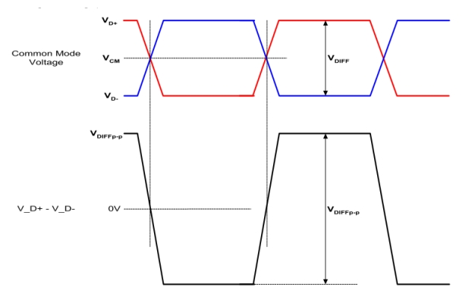
4.3 eDP Interface
Item | Symbol | Min | Typ | Max | Unit | Remark
Spread spectrum clock | ssc |  |  | 0.5 | %
Differential peak-to-peak input voltage at package pins | VRX-DIFFp-p | 100 | - | 1320 | mV
Rx input DC common mode voltage | VRX_DC_CM | 0 | - | 2 | V
Differential termination resistance | RRX-DIFF | 80 | - | 120 | Ω
Single-ended termination resistance | RRX-SE | 40 | - | 60 | Ω
Rx short circuit current limit | IRX_SHORT | - | - | 50 | mA
Intra-pair skew at Rx package pins (HBR) RX intra-pair skew tolerance at HBR | LRX_SKEW_ INTRA_PAIR | - | - | 50 | ps

Slide 12
5.0 SIGNAL TIMING SPECIFICATION
5.0.1 Timing Parameters
Parameter | Symbol | Value |  |  | Unit
 |  | Min. | Typ. | Max.
DCLK Frequency | fclk | 138.5 | 148.5 | 153.2 | MHz
Horizontal display area | thd | 1920 |  |  | pixel
HSYNC period time | th | 2080 | 2200 | 2240 | pixel
HSYNC blanking | thb+ thfp | 160 | 280 | 320 | pixel
Vertical display area | Tvd | 1080 |  |  | H
Frequency | fV | 57 | 60 | - | Hz
VSYNC period time | Tv | 1110 | 1125 | 1140 | H
VSYNC blanking | Tvb+ Tvfp | 30 | 45 | 60 | H
Note
1. Best operation clock frequency is 148.5Mhz.
2. Frequency = [H Total] * [V Total] * [vertical Frame rate]
H Total, V Total and Frame rate]should operate within the range between Frequency_Min and Frequency_Max
3. Except Best operation clock frequency, FOS(Flicker & Brightness & Crosstalk, Etc.) are not guaranteed.
4. Main frequency Max is 60Hz

Slide 13
6.0 POWER SEQUENCE
To prevent a latch-up or DC operation of the LCD FOB, the power on/off sequence shall be as shown in below
90%
90%
Power Supply for Logic Vdd
10%
10%
10%
T1
T2
T10
T11
T12
eDP Display
Black Video
Video form Source
Black Video
HPD from Sink
T3
Sink Aux CH
AUX Channel Operational
Source Main-Link Data
T4
T7
Link Training
Idle
Idle or off
T5
T6
T8
T9
LED_EN
PWM
Power Supply for BL (VBL )
90%
90%
10%
T13
T16
10%
T17
T14
T15
T18
Figure 15. Power Sequence
● 0.5ms ≤ T1 ≤ 10 ms
● 0ms ≤ T2 ≤ 200 ms
● 0ms ≤ T3 ≤ 200 ms
● 0ms ≤ T13
● 0ms ≤ T14
● 0ms ≤ T17
● 80ms ≤ T8
● 0ms ≤ T7 ≤ 50ms
● 0ms ≤ T10 ≤ 500 ms
● 0.5ms ≤ T11 ≤ 10 ms
● 500ms ≤ T12
● 0ms ≤ T15
● 0ms ≤ T16
● 0ms ≤ T18
Notes:
When the power supply VDD is 0V, keep the level of input signals on the low or keep high
impedance.
2. Do not keep the interface signal high impedance when power is on. Back Light must be turn on after power for logic and interface signal are valid.

Slide 14
7.0 OPTICAL SPECIFICATION
7.0.1 Overview
The test of view angle range shall be measured in a dark room (ambient luminance ≤ 1lux and temperature = 25±2℃) with the equipment of Luminance meter system (Goniometer system and TOPCON CS2000/CA310) and test unit shall be located at an approximate distance 50cm from the LCD surface at a viewing angle of θ and Φ equal to 0°. We refer to θØ=0 (=θ3 ) as the 3 o’clock direction (the “right”), θ Ø=90 (= θ12 ) as the 12 o’clock direction (“upward”), θ Ø=180 (= θ9 ) as the 9 o’clock direction (“left”) and θ Ø=270(= θ6 ) as the 6 o’clock direction (“bottom”). While scanning θ and/or Ø, the center of the measuring spot on the Display surface shall stay fixed. The luminance, color and uniformity (etc) should be tested by CS2000/CA310. The backlight should be operating for 10 minutes prior to measurement. VDD shall be 3.3 ± 0.3V at 25°C. Optimum viewing angle direction is 6 ’clock
<Table 7. Optical Specifications>
Parameter |  | Symbol | Condition | Min. | Typ. | Max. | Unit | Remark
Viewing Angle range | Horizontal | Θ₃ | CR > 10 | 80 | 85 | - | Deg. | Note 1
 |  | Θ₉ |  | 80 | 85 | - | Deg.
 | Vertical | Θ₁₂ |  | 80 | 85 | - | Deg.
 |  | Θ₆ |  | 80 | 85 | - | Deg.
Luminance Contrast ratio |  | CR | Θ = 0° | 600 | 800 | - |  | Note 2
Color Gamut | NTSC | CIE1931 | Θ = 0° | 68 | 72 | - | % | Note 5
Reproduction of color | White | Wx | Θ = 0° | Typ -0.03 | 0.313 | Typ +0.03
 |  | Wy |  |  | 0.329
Response Time |  | Tr+Td | Ta= 25° C Θ = 0° | - | 30 | 35 | ms | Note 6

Slide 15
Notes : 1. Viewing angle is the angle at which the contrast ratio is greater than 10. The
viewing angles are determined for the horizontal or 3, 9 o’clock direction and
the vertical or 6, 12 o’clock direction with respect to the optical axis which is
normal to the LCD surface (see FIGURE 1).
2. Contrast measurements shall be made at viewing angle of Θ= 0 and at the
center of the LCD surface. Luminance shall be measured with all pixels in
the view field set first to white, then to the dark (black) state . (see FIGURE
1) Luminance Contrast Ratio (CR) is defined mathematically.
3. Luminance of white is defined as luminance values of center of the LCD
surface. Luminance shall be measured with all pixels in the view field set first
to white. This measurement shall be taken at the locations shown in FIGURE
2 for a total of the measurements per display. The luminance is measured by
CS2000/CA310 when the LED current is set at 60mA.
4. The color chromaticity coordinates specified in Table 5. shall be calculated
from the spectral data measured with all pixels first in red, green, blue and
white. Measurements shall be made at the center of the panel.
5. The electro-optical response time measurements shall be made as FIGURE
3 by switching the “data” input signal ON and OFF. The times needed for the
luminance to change from 10% to 90% is Tr, and 90% to 10% is Td.
CR = |  | Luminance when displaying a white raster
 |  | Luminance when displaying a black raster

Slide 16
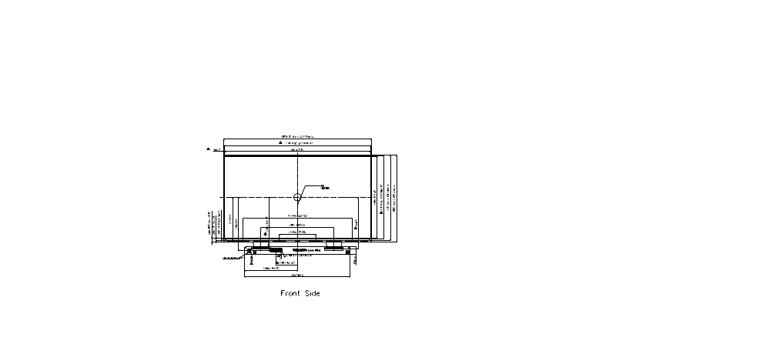
8.0 MECHANICAL OUTLINE DIMENSION
Figure 4. TFT-LCD FOB Outline Dimension (Front View)

Slide 17
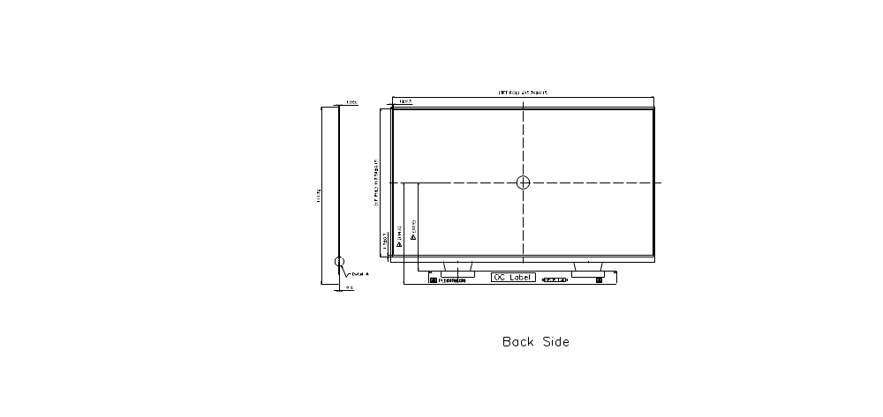
Figure 5. TFT-LCD FOB Outline Dimensions (Rear view)
21

Slide 18
9.0 RELIABILITY TEST
The Reliability test items and its conditions are shown in below.
<Table 8. Reliability test>
No | Test Items | Conditions | Remark
1 | High temperature storage test | Ta = 60°C , 60%RH, 240 hrs
2 | Low temperature storage test | Ta = -20°C , 240 hrs
3 | High temperature & high humidity operation test | Ta = 50°C , 80%RH, 240 hrs
4 | High temperature operation test | Ta = 50°C , 60%RH, 240 hrs
5 | Low temperature operation test | Ta = 0°C , 240 hrs
6 | Thermal shock | Ta = -20 °C ↔ 60 °C (0.5 hr), 60%±3%RH, 100 cycle
7 | Vibration test (non-operating) | Ta = 25°C , 60%RH, 1.5G, 10~500Hz, Sine X,Y,Z / Sweep rate : 1 hour | Note 1
8 | Shock test (non-operating) | Ta = 25°C , 60%RH, 220G, Half Sine Wave 2msec±X,±Y,±Z Once for each direction | Note 1
9 | Electro-static discharge test (operating LCM Level) | Air : 150 pF, 330Ω, ±15 KV Contact : 150 pF, 330Ω, ±8 KV Ta = 25°C , 60%RH, | Note 2
Notes :
1. The fixture must be hard enough , so that the FOB would not be twisted or bent.
2. Self- recovery and restart recovery is allowed. No hardware failures.

Slide 19
10.0 Precautions
Please pay attention to the followings when you use this TFT LCD Panel.
  11.1 Mounting Precautions
  (1) Use fingerstalls with soft gloves in order to keep display clean during the incoming
inspection and assembly process.
(2) You must mount a FOB using specified mounting holes (Details refer to the drawings).
(3) Please make sure to avoid external forces applied to the Source PCB or FPC and D-IC
during the process of handling or assembling. If not, It causes panel damage or malfunction.
(4) Note that polarizers are very fragile and could be easily damaged. Do not touch, push or rub
the exposed polarizers with glass, tweezers or anything harder than HB pencil lead. And please do not rub with dust clothes with chemical treatment.
(5) Do not pull or fold the source D-IC which connect the source PCB or FPC and the panel.
Do not pull or fold the LED wire.
(6) After removing the protective film, when the surface becomes dusty, please wipe gently with
absorbent cotton or other soft materials like chamois soaks with alcohol or purified water.
Do not strong polar solvent because they cause chemical damage to the polarizer.
(7) Wipe off saliva or water drops as soon as possible. Their long time contact with polarizer
causes deformations and color fading.
(8) Protection film for polarizer on the FOB shall be slowly peeled off just before use so that
the electrostatic charge can be minimized.
(9) Since the LCD is made of glass, do not apply strong mechanical impact or static load onto it.
Handling with care since shock, vibration, and careless handling may seriously affect the product. If it falls from a high place or receives a strong shock, the glass may be broken.
(10) Do not disassemble the FOB.
(11) To determine the optimum mounting angle, refer to the viewing angle range in the specification for each model.
(12) If the customer's set presses the main parts of the LCD, the LCD may show the abnormal
display. But this phenomenon does not mean the malfunction of the LCD and should be pressed by the way of mutual agreement.
(13)Do not drop water or any chemicals onto the LCD’s surface.

Slide 20
  10.1 Operating Precautions
(1) Be careful for condensation at sudden temperature change. Condensation makes damage to
polarizer or electrical contacted parts. And after fading condensation, smear or spot will occur.
(2) FOB has high frequency circuits. Sufficient suppression to the electromagnetic
interference shall be done by system manufacturers. Grounding and shielding methods may be important to minimized the interference.
(3) The electrochemical reaction caused by DC voltage will lead to LCD degradation, so DC
drive should be avoided.
(4) The LCD FOBs use C-MOS LSI drivers, so customers are recommended that any unused
input terminal would be connected to Vdd or Vss, do not input any signals before power is turn on, and ground you body, work/assembly area, assembly equipments to protect against static electricity.
(5) Do not exceed the absolute maximum rating value. (supply voltage variation, input voltage
variation, variation in part contents and environmental temperature, and so on) Otherwise the FOB may be damaged.
(6) Design the length of cable to connect between the connector for back-light and the converter
as short as possible and the shorter cable shall be connected directly.
The longer cable between that of back-light and that of converter may cause the luminance of LED to lower and need a higher startup voltage(Vs).
(7) Connectors are precise devices for connecting PCB and transmitting electrical signals. Operators should insert and unplug MDL in parallel when assembling MDL.
(8) Do not connect or disconnect the cable to/ from the FOB at the "Power On" condition.
(9) When the FOB is operating, do not lose CLK, ENAB signals. If any one these
signals is lost, the LCD panel would be damaged.
(10) Obey the supply voltage sequence. If wrong sequence is applied, the FOB would be damaged.
(11) Do not re-adjust variable resistor or switch etc.
10.2 Electrostatic Discharge Control
(1) Since a FOB is composed of electronic circuits, it is not strong to electrostatic discharge.
Make certain that treatment persons are connected to ground through wrist band etc. And
don’t touch interface pin directly. Keep products as far away from static electricity as possible.
(2) Avoid the use work clothing made of synthetic fibers. We recommend cotton clothing or other conductivity-treated fibers.

Slide 21
10.3 Precautions for Strong Light Exposure
It is not allowed to store or Operate directly in strong light or in high temperature and humidity for a long time; Strong light exposure causes degradation of polarizer and color filter.
  10.4 Storage Precautions
  When storing FOBs as spares for a long time, the following precautions are necessary.
  (1) Control of ventilation and temperature is necessary.
  (2) Please make sure to protect the product from strong light exposure, water or moisture.
  Be careful for condensation.
  (3) Store in a polyethylene bag with sealed so as not to enter fresh air outside in it.
(4)Do not store the LCD near organic solvents or corrosive gasses.
  (5) Please keep the FOB at a circumstance shown below Fig.
  10.5 Precautions for Protection Film
  (1) Remove the protective film slowly, keeping the removing direction approximate
  30-degree not vertical from panel surface, If possible, under ESD control device like ion blower, and the humidity of working room should be kept over 50%RH to reduce the risk of static charge.
  (2) In handling the LCD, wear non-charged material gloves. And the conducting wrist to the earth and the conducting shoes to the earth are necessary.
  10.6 Appropriate Condition for Display
  (1) Normal operating condition
  - Temperature: 0 ~ 40℃
  - Operating Ambient Humidity : 10 ~ 90 %
  - Display pattern: dynamic pattern (Real display)
  -Long-term lighting products recommended regular shutdown
  (2) Special operating condition
  If the product will be used in extreme conditions such as high temperature, humidity, display patterns or 7*24hrs operation time etc.., It is strongly recommended to contact BOE for Application engineering advice. Otherwise, its reliability and function may not be guaranteed.
  (3)Black image or moving image is strongly recommended as a screen save.

Slide 22
  (4) Lifetime in this spec. is guaranteed only when commercial display is used according to
  operating usages.
  (5) Please contract BOE in advance when you want to switch between portrait and
  landscape screen
  (6) Please contact BOE in advance for outdoor operation.
  (7) Please contact BOE in advance when you display the same pattern for a long time.
  (8) If the FOB keeps displaying the same pattern for a long period of time, the image may be
  "sticked" to the screen. To avoid image sticking, it is recommended to use a screen saver.
  (9) Do not exceed the absolute maximum rating value. (supply voltage variation, input voltage
  variation, variation in part contents and environmental temperature, and so on) Otherwise the FOB may be damaged.
  (10) Dew drop atmosphere should be avoided.
  (11) The storage room should be equipped with a good ventilation facility and avoid to expose to corrosive gas , which has a temperature controlling system.
  (12) When expose to drastic fluctuation of temperature (hot to cold or cold to hot） ,the LCD may be affected; Specifically, drastic temperature fluctuation from cold to hot ,produces dew on the LCD's surface which may affect the operation of the polarizer and the LCD.
  (13) Response time will be extremely delayed at lower temperature than the operating temperature range and on the other hand at higher temperature LCD may turn black at temperature above its operational range. However those phenomena do not mean malfunction or out of order with the LCD. The LCD will revert to normal operation once the temperature returns to the recommended temperature range for normal operation
  10.7 Others
  A. LC Leak
If the liquid crystal material leaks from the panel, it is recommended to wash the LC with acetone or ethanol and then burn it.
In case of contact with hands, skin or clothes, it has to be washed away thoroughly with soap.
If LC in mouth, mouth need to be washed, drink plenty of water to induce vomiting and follow medical advice.
If LC touch eyes, eyes need to be washed with running water at least 15 minutes.
B. Rework
When returning the FOB for repair or etc., Please pack the FOB not to be broken. We recommend to use the original shipping packages.

Slide 23
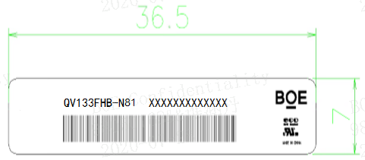
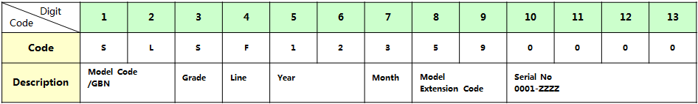
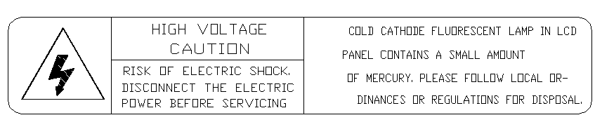
11.0 LABEL
(1) Product label
Figure 6. Product Label
FOB ID Naming Rule:
<Table 7. FOB ID Naming Rule>
(2) High voltage caution label

Slide 24
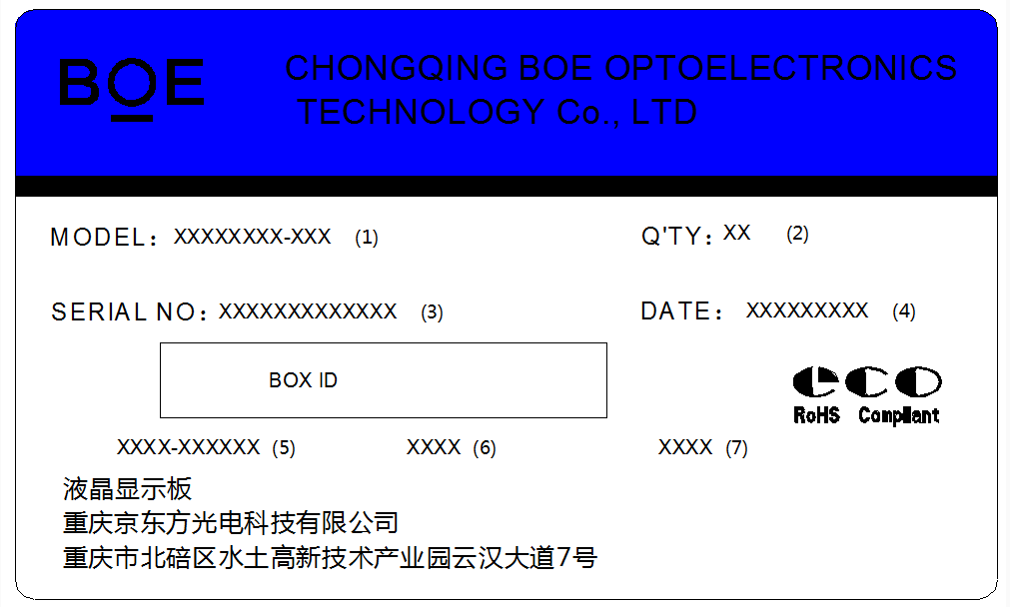
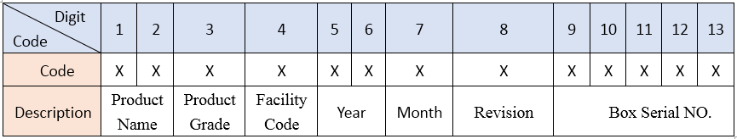
(3) Box label
Figure7. Box Label
Serial number marked part needs to print, show as follows:
1. FG-CODE(Before 12 bit) 2. Product quantity
3. Box ID 4. Date
The client section material number(The client)
FG-Code After four
The supplier code
Total Size:100×60mm
<Table 8. Box Label Naming Rule >

Slide 25
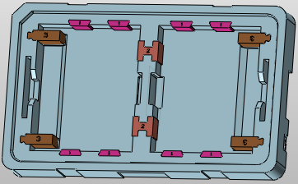

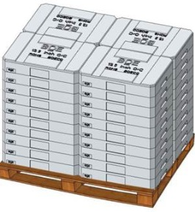
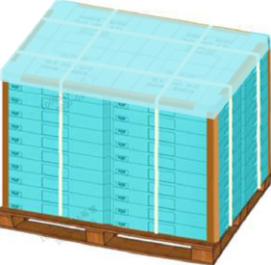
12.0 PACKING INFORMATION
Spacer
OC
Spacer
Box Label粘贴处
Step 1
Step 2
将1pcs Spacer放置于Box一个产品槽底部，将OC平放入Box底Spacer上（CF朝上，PCB朝外），重复以上动作，最后顶层放置1pcs Spacer。（另一产品槽同理）
19 OC*2/Box， 20 Spacer*2 /Box
将2袋干燥剂放入Box内，并粘贴Box Label于Box长边侧壁中心位置。
2 Drier/Box
Packing Belt
Protection Film
Pallet Label粘贴处
Paper Corner
缠绕膜
Step 3
Step 4
在Pallet上放置一纸板，按照2×2×10形式将40ea Box依次堆叠于Pallet上，并分别在顶层Box上放置1ea Box Cover。
1,520 OC/40 Box ASSY/4 Box Cover/Pallet
将1张PE防护膜放置于Box Cover上，放置8ea纸护角，长和宽边分别捆扎两道打包带固定，缠绕膜2圈裹包，并粘贴Pallet标签于Pallet长边顶层中心位置，避让Box Label。
1,520 OC/8 Paper Corner/Pallet

Slide 26
13.0 EDID Table
Address (HEX) | Function | Hex | Dec | Input values. | Notes
00 | Header | 00 | 0 | 0 | EDID Header
01 |  | FF | 255 | 255
02 |  | FF | 255 | 255
03 |  | FF | 255 | 255
04 |  | FF | 255 | 255
05 |  | FF | 255 | 255
06 |  | FF | 255 | 255
07 |  | 00 | 0 | 0
08 | ID Manufacturer Name | 09 | 9 | BOE | ID = BOE
09 |  | E5 | 229
0A | ID Product Code | 5B | 91 | 2907 | ID = 2907
0B |  | 0B | 11
0C | 32-bit serial No. | 00 | 0 | 0
0D |  | 00 | 0 | 0
0E |  | 00 | 0 | 0
0F |  | 00 | 0 | 0
10 | Week of manufacture | 1B | 27 | 27
11 | Year of Manufacture | 20 | 32 | 2022 | Manufactured in 2022
12 | EDID Structure Ver. | 01 | 1 | 1 | EDID Ver 1.0
13 | EDID revision # | 04 | 4 | 4 | EDID Rev. 0.4
14 | Video input definition | A5 | 165 | -
15 | Max H image size | 1D | 29 | 29 | 29 cm (Approx)
16 | Max V image size | 10 | 16 | 17 | 17 cm (Approx)
17 | Display Gamma | 78 | 120 | 2.2 | Gamma curve = 2.2
18 | Feature support | 02 | 2 |  | RGB display, Preferred Timming mode
19 | Red/Green low bits | 9C | 156 | - | Red / Green Low Bits
1A | Blue/White low bits | A2 | 162 | - | Blue / White Low Bits
1B | Red x high bits | A6 | 166 | 0.651 | Red (x) = 10100110 (0.651)
1C | Red y high bits | 58 | 88 | 0.345 | Red (y) = 01011000 (0.345)
1D | Green x high bits | 54 | 84 | 0.328 | Green (x) = 01010100 (0.328)
1E | Green y high bits | 9F | 159 | 0.622 | Green (y) = 10011111 (0.622)
1F | Blue x high bits | 26 | 38 | 0.151 | Blue (x) = 00100110 (0.151)
20 | BLue y high bits | 0E | 14 | 0.057 | Blue (y) = 00001110 (0.057)
21 | White x high bits | 4D | 77 | 0.301 | White (x) = 01001101 (0.301)
22 | White y high bits | 55 | 85 | 0.334 | White (y) = 01010101 (0.334)
23 | Established timing 1 | 00 | 0 | -
24 | Established timing 2 | 00 | 0 | -

Slide 27
13.0 EDID Table
25 | Established timing 3 | 00 | 0 | -
26 | Standard timing #1 | 01 | 1 |  | Not Used
27 |  | 01 | 1
28 | Standard timing #2 | 01 | 1 |  | Not Used
29 |  | 01 | 1
2A | Standard timing #3 | 01 | 1 |  | Not Used
2B |  | 01 | 1
2C | Standard timing #4 | 01 | 1 |  | Not Used
2D |  | 01 | 1
2E | Standard timing #5 | 01 | 1 |  | Not Used
2F |  | 01 | 1
30 | Standard timing #6 | 01 | 1 |  | Not Used
31 |  | 01 | 1
32 | Standard timing #7 | 01 | 1 |  | Not Used
33 |  | 01 | 1
34 | Standard timing #8 | 01 | 1 |  | Not Used
35 |  | 01 | 1
36 | Detailed timing/monitor descriptor #1 | C0 | 192 | 147.8 | 147.84MHz Main clock
37 |  | 39 | 57
38 |  | 80 | 128 | 1920 | Hor Active = 1920
39 |  | 18 | 24 | 280 | Hor Blanking = 280
3A |  | 71 | 113 | - | 4 bits of Hor. Active + 4 bits of Hor. Blanking
3B |  | 38 | 56 | 1080 | Ver Active = 1080
3C |  | 28 | 40 | 40 | Ver Blanking = 40
3D |  | 40 | 64 | - | 4 bits of Ver. Active + 4 bits of Ver. Blanking
3E |  | 30 | 48 | 48 | Hor Sync Offset = 48
3F |  | 20 | 32 | 32 | H Sync Pulse Width = 32
40 |  | 36 | 54 | 3 | V sync Offset = 3 line
41 |  | 00 | 0 | 6 | V Sync Pulse width : 6 line
42 |  | 24 | 38 | 294 | Horizontal Image Size = 293.76 mm (Low 8 bits)
43 |  | A5 | 165 | 165 | Vertical Image Size = 165.24 mm (Low 8 bits)
44 |  | 10 | 16 | - | 4 bits of Hor Image Size + 4 bits of Ver Image Size
45 |  | 00 | 0 | 0 | Hor Border (pixels)
46 |  | 00 | 0 | 0 | Vertical Border (Lines)
47 |  | 1A | 26 | - | Refer to right table

Slide 28
13.0 EDID Table
48 | Detailed timing/monitor descriptor #2 | 00 | 0 | 0 | 0MHz Main clock
49 |  | 00 | 0
4A |  | 00 | 0 | 0 | Hor Active = 0
4B |  | 00 | 0 | 0 | Hor Blanking = 0
4C |  | 00 | 0 | - | 4 bits of Hor. Active + 4 bits of Hor. Blanking
4D |  | 00 | 0 | 0 | Ver Active = 0
4E |  | 00 | 0 | 0 | Ver Blanking = 0
4F |  | 00 | 0 | - | 4 bits of Ver. Active + 4 bits of Ver. Blanking
50 |  | 00 | 0 | 0 | Hor Sync Offset = 0
51 |  | 00 | 0 | 0 | H Sync Pulse Width = 0
52 |  | 00 | 0 | 0 | V sync Offset = 0 line
53 |  | 00 | 0 | 0 | V Sync Pulse width : 0 line
54 |  | 00 | 0 | 0 | Horizontal Image Size = 0 mm (Low 8 bits)
55 |  | 00 | 0 | 0 | Vertical Image Size = 0 mm (Low 8 bits)
56 |  | 00 | 0 | - | 4 bits of Hor Image Size + 4 bits of Ver Image Size
57 |  | 00 | 0 | 0 | Hor Border (pixels)
58 |  | 00 | 0 | 0 | Vertical Border (Lines)
59 |  | 00 | 0 | -
5A | Detailed timing/monitor descriptor #3 | 00 | 0 |  | Indicates descriptor #3 is a display Descriptor
5B |  | 00 | 0
5C |  | 00 | 0 |  | Reserved
5D |  | FE | 254 |  | Tag：ASCII String
5E |  | 00 | 0 |  | Reserved
5F |  | 42 | 66 | B | Manufacture name : BOECQ
60 |  | 4F | 79 | O
61 |  | 45 | 69 | E
62 |  | 20 | 32
63 |  | 43 | 67 | C
64 |  | 51 | 81 | Q
65 |  | 0A | 10
66 |  | 20 | 32
67 |  | 20 | 32
68 |  | 20 | 32
69 |  | 20 | 32
6A |  | 20 | 32
6B |  | 20 | 32

Slide 29
13.0 EDID Table
6C | Detailed timing/monitor descriptor #4 | 00 | 0 |  | Indicates descriptor #4 is a display Descriptor
6D |  | 00 | 0
6E |  | 00 | 0 |  | Reserved
6F |  | FE | 254 |  | Tag：ASCII String
70 |  | 00 | 0 |  | Reserved
71 |  | 51 | 81 | Q | Model name:EV133FHM-N40
72 |  | 56 | 86 | V
73 |  | 31 | 49 | 1
74 |  | 33 | 51 | 3
75 |  | 33 | 51 | 3
76 |  | 46 | 70 | F
77 |  | 48 | 72 | H
78 |  | 42 | 66 | B
79 |  | 2D | 45 | -
7A |  | 4E | 78 | N
7B |  | 38 | 56 | 8
7C |  | 31 | 49 | 1
7D |  | 0A | 10 | 0
7E | Extension flag | 00 | 0 | 1 | 0 ：1個EDID；N-1：N个EDID
7F | Checksum | 8E | 142 | 142

